Slide 1
Unbounded Frank-Wolfe Algorithms Applied to the Generalized LASSO Problem

Slide 2

Contents
Introduction
Generalized lasso problem
Data generation
Generalized lasso in UFW
Gradient step size
Computing projections
LMO
FW step size
FW away step
Results
Conclusions

Slide 3
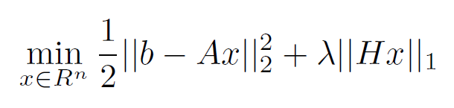
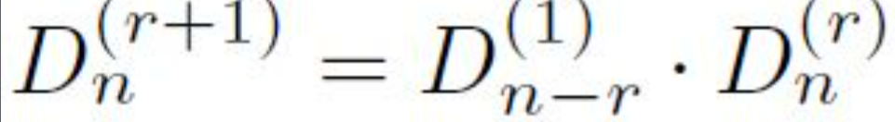
Introduction
Generalized Least Absolute Shrinkage and Selection Operator
Unbounded Frank-Wolfe Algorithm

Slide 4
Data Generation
Synthetic Data Generation
N=1000
n=500
Signal-to-noise Ratio=1

Slide 5
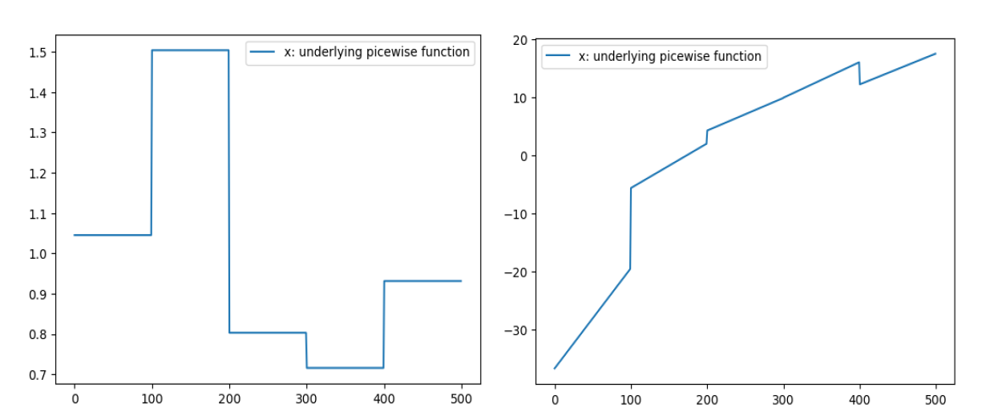

Data Generation
r=1 r=2
Response vectors calculated with using:
Vector of regression coefficients
Underlying model coefficient
Noise

Slide 6
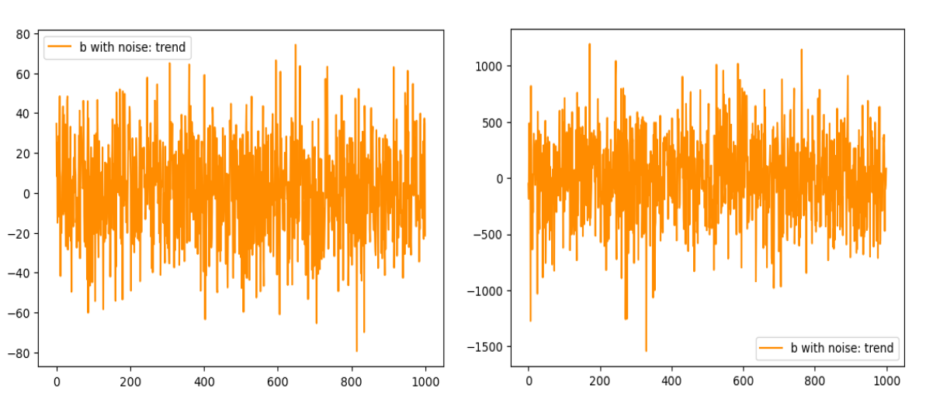

Data Generation
r=1 r=2
SNR=1 case

Slide 7
Unbounded Frank-Wolfe

Slide 8
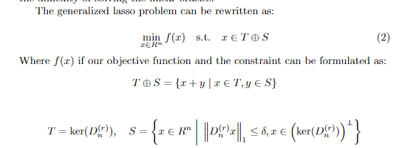
Generalized Lasso Problem

Slide 9

Gradient Step Size
Author’s Suggestion =
Alternative Method =

Slide 10
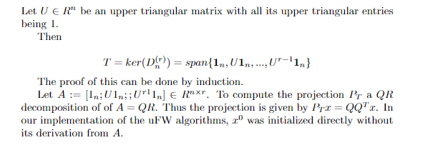

Computing Projections onto T and $T^{⊥}$

Slide 11
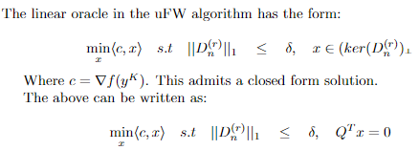
Solving the Linear Subproblem

Slide 12
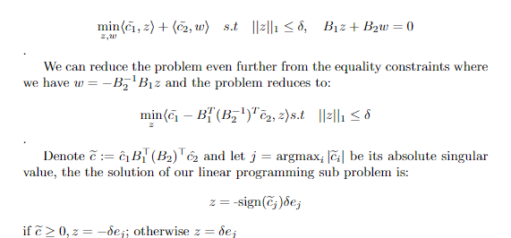
Solving the Linear Subproblem

Slide 13
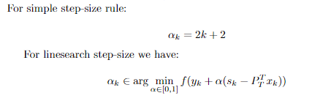
Frank Wolfe Step Size

Slide 14
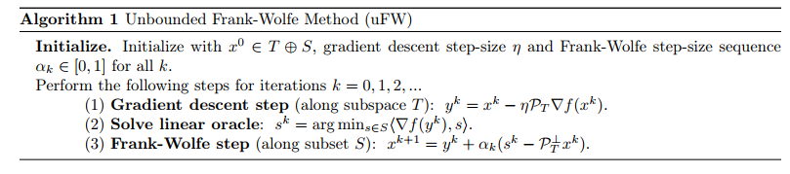
Unbounded Frank-Wolfe Algorithm

Slide 15
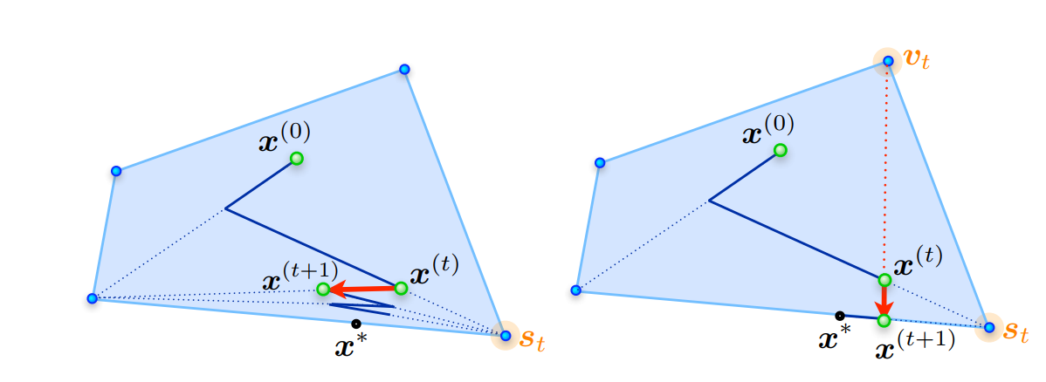
Problem with FW
Traditional FW convergence: sublinear
Zig-zaging of FW when the solution lays on the edge

Slide 16
Improvement: Away-Step FW
Improves with an away step, which achieves a linear convergence rate, also in the unbounded case
Away step implemented

Slide 17
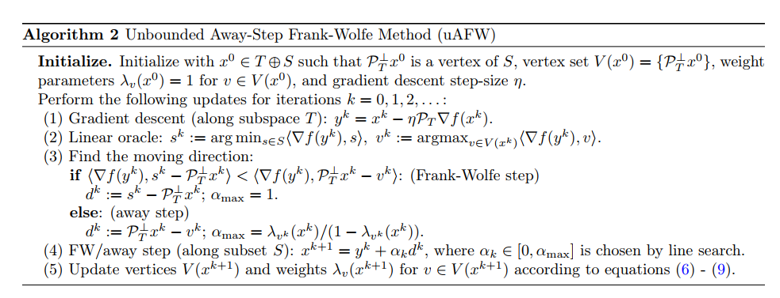

Unbounded Away-Step Frank Wolfe
Second linear oracle for $v^{k}$
Choose the direction whose projection onto the gradient is the smallest
Keep track of vertices and weights, updating them

Slide 18
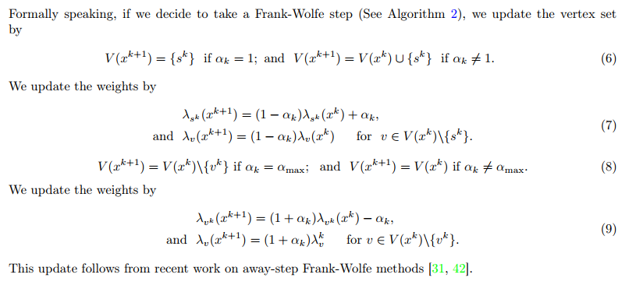
Update of the vertices and weights in uAFW

Slide 19

Results

Slide 20


Metrics
Optimal solution gap: objective value – MOSEK optimal solution
$G_{k }$: primal dual gap
$H_{k }$: norm of the projection onto T of the gradient
Possible termination: when both values are small

Slide 21

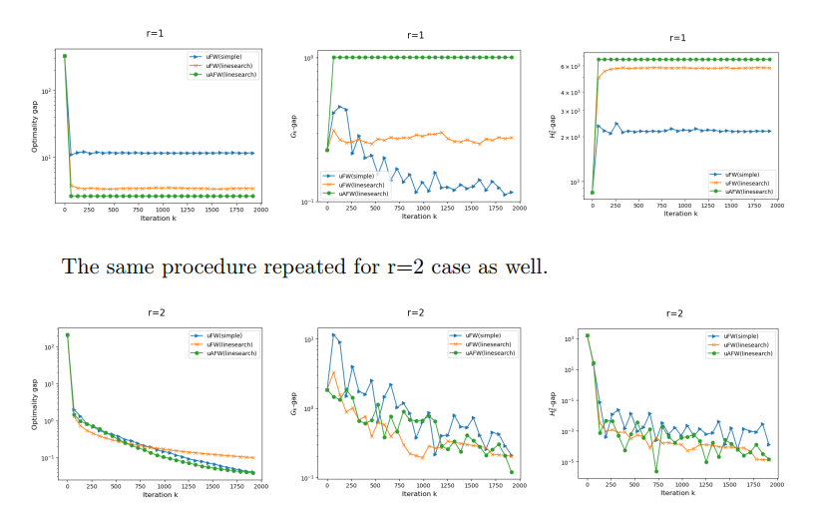
Single repetition #1

Slide 22
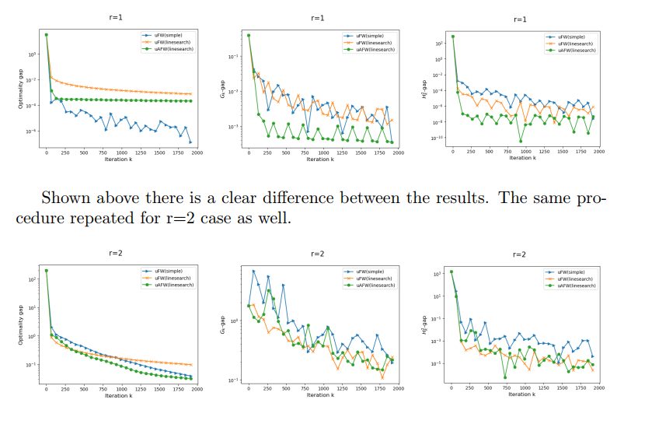
Single repetition #2

Slide 23
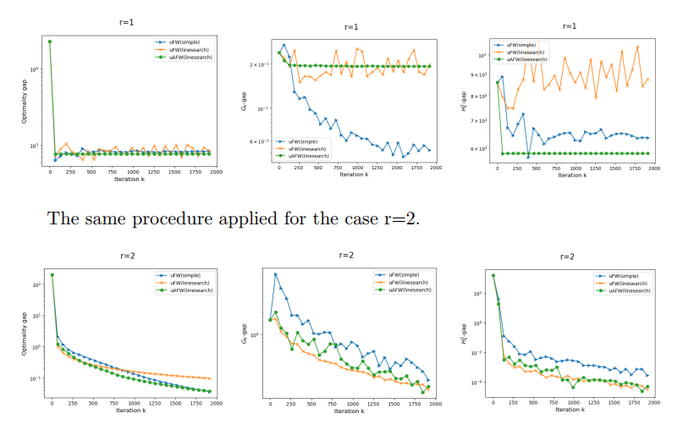
Average: 10 repetitions

Slide 24
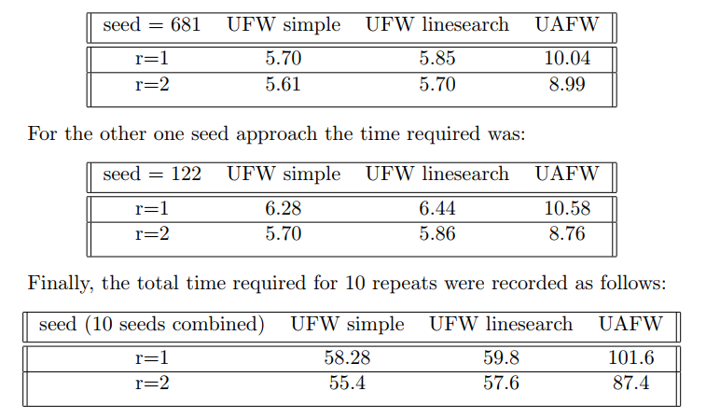
Running time comparison

Slide 25




Conclusion
r=1
r=2
Gradient step size

Slide 26
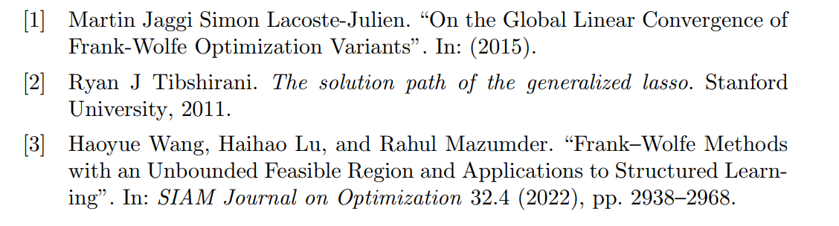
References

